Slide 1
ENGR 216-(538-543) Dr. Tanya Wickliff
Engineering Mechanics: The Introduction

Slide 2
Instructor Information:
Dr. Tanya Dugat Wickliff
Professor of Engineering Practice
Office: ZACH 400 F
Email: tdwickliff@tamu.edu
713-487-9776 (but it is much easier to get in touch with me via email)
Office hours: F 2-3 or by appointment

Slide 3
Welcome back!
The Why of the Course
The Who of the Course
The What of the Course
The Where of the Course
The When of the Course
The How of the Course

Slide 4
Why?
Engineering Mechanics is important across many fields of engineering
Past students have complained that they felt disconnected from ENGR in PHYS 218
We will try to inject some engineering content into mechanics
We will also cover material you will use throughout your curriculum

Slide 5
Who?
You have 1) an engineering instructor (me!), and 2) a set of PTs/GATs (kind of like ENGR 102)
Instructor will lead lecture
PTs/GATs will lead labs
Grading done by instructor/PTs/GATs
Final grade determined by instructor

Slide 6
What?
7 labs
Cover various aspects of engineering mechanics
14 lectures
7 prepare you for the labs
7 cover other aspects of engineering and analysis

Slide 7
Where?
Lectures take place here (ZACH 353)
Labs take place in ZACH 398
There are 5 sub-rooms in ZACH 398 (B,D,E,F,G)
Make sure you go to the right one

Slide 8
When?
Lectures take place for 1 hr once a week
You must attend lecture
Labs take place for 3 hr once a week
Each lab (except Lab 1) is allocated 2 weeks
Plan – do the experiment in week 1
Use week 2 of lab to correct mistakes, ask PTs/GATs questions
Lab report is due one week after lab is finished, regardless of how you plan your time!

Slide 9
How?
Lectures will have HW
Labs will have lab reports
5 written
2 video
Labs will be done in teams
You will assigned teams for Labs 2 – 7
Lab 1 just do in a group of 4 (or 3)
There will be a final on lecture material during finals period (time/date TBD)

Slide 10
Syllabus Time

Slide 11
Remember
No lab in Week 1
You need either a RJ45 port on your laptop, or an adapter

Slide 12
Propagation of Error
ENGR 216

Slide 13
Errors
All measurements have errors
Sometimes we want to calculate quantities based on measurements
We want to determine the error in the calculated quantity based on the errors in the measurements
You’re going to be measuring things in the class – you will therefore need to report errors

Slide 14
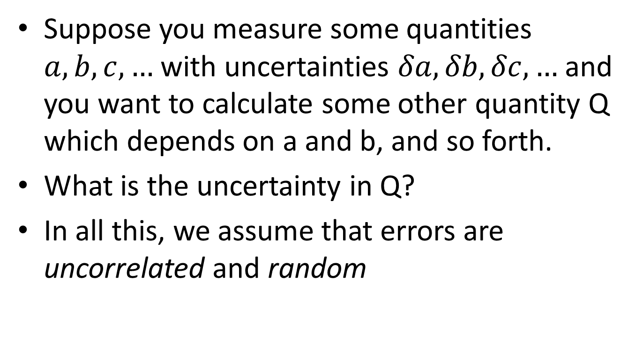
Error Propagation
Suppose you measure some quantities $a,b,c,…$ with uncertainties $δa,δb,δc,…$ and you want to calculate some other quantity Q which depends on a and b, and so forth.
What is the uncertainty in Q?
In all this, we assume that errors are uncorrelated and random

Slide 15
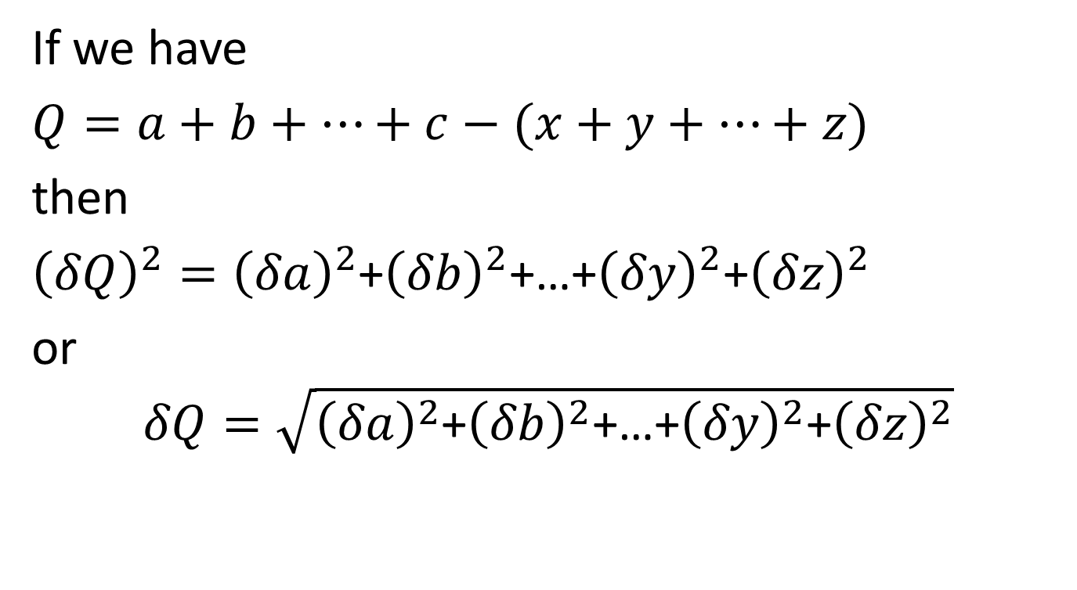
Additive or Subtractive Errors add as squares
If we have
$Q=a+b+…+c−(x+y+…+z)$
then
${\left(δQ\right)}^{2}={\left(δa\right)}^{2}$+${\left(δb\right)}^{2}$+…+${\left(δy\right)}^{2}$+${\left(δz\right)}^{2}$
or
$$δQ=\sqrt{{\left(δa\right)}^{2}\text{+}{\left(δb\right)}^{2}\text{+…+}{\left(δy\right)}^{2}\text{+}{\left(δz\right)}^{2}}$$

Slide 16
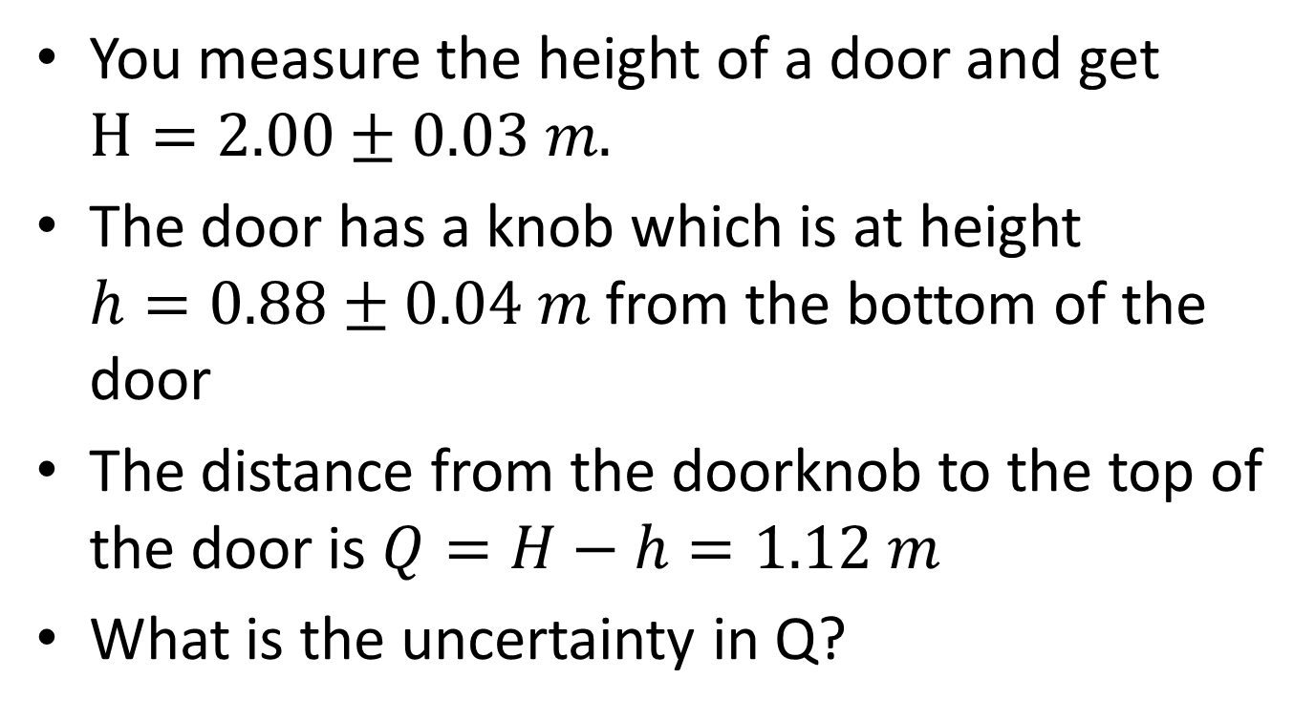
Example
You measure the height of a door and get $H=2.00±0.03 m.$
The door has a knob which is at height $h=0.88±0.04 m$ from the bottom of the door
The distance from the doorknob to the top of the door is $Q=H−h=1.12 m$
What is the uncertainty in Q?

Slide 17
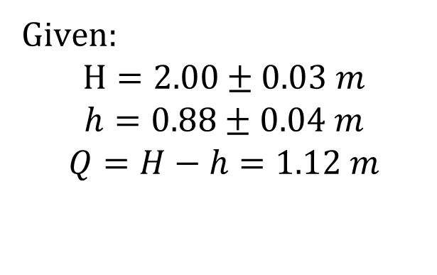
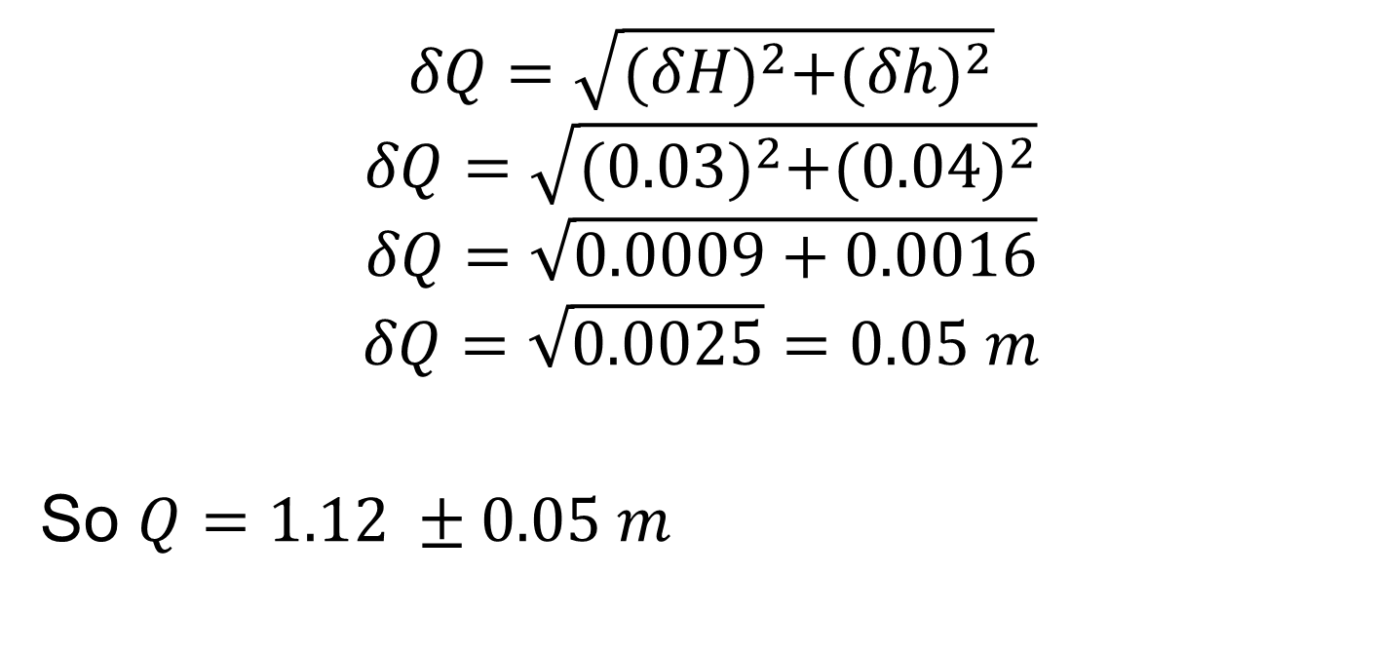
Example cont.
Given:
$$H=2.00±0.03 m$$
$$h=0.88±0.04 m$$
$$Q=H−h=1.12 m$$
$$δQ=\sqrt{{(δH)}^{2}+{(δh)}^{2}}$$
$$δQ=\sqrt{{(0.03)}^{2}+{(0.04)}^{2}}$$
$$δQ=\sqrt{0.0009+0.0016}$$
$$δQ=\sqrt{0.0025}=0.05 m$$
So $Q=1.12 ±0.05 m$

Slide 18
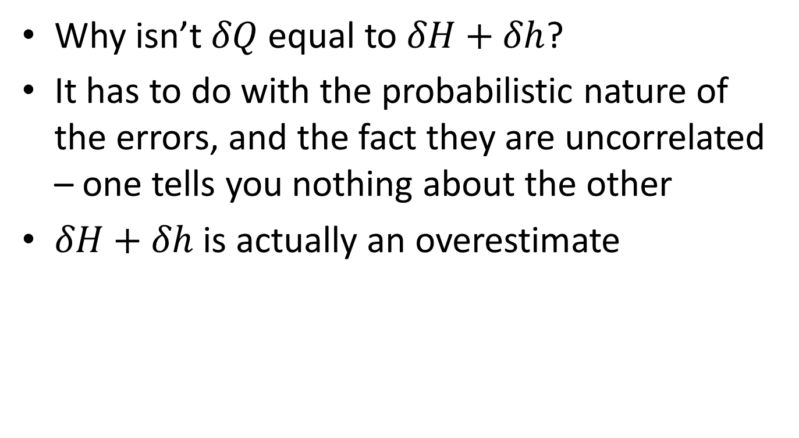
You might ask…
Why isn’t $δQ$ equal to $δH+δh$?
It has to do with the probabilistic nature of the errors, and the fact they are uncorrelated – one tells you nothing about the other
$δH+δh$ is actually an overestimate

Slide 19
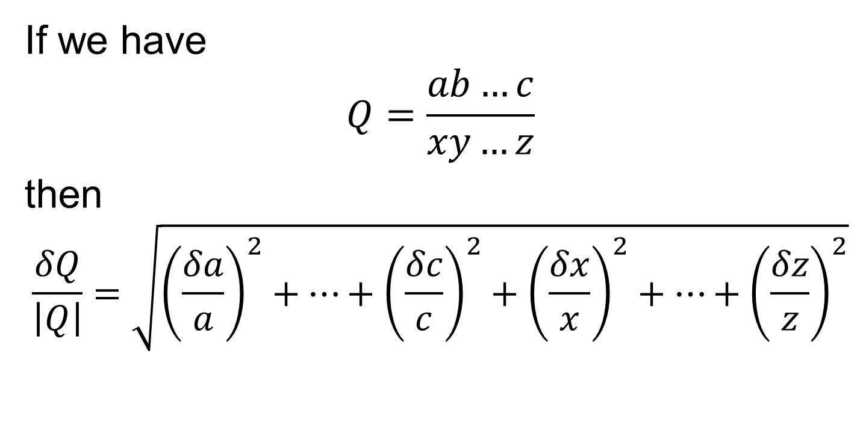
Fractional Multiplication or Division Errors add as squares
If we have
$$Q=\frac{ab…c}{xy…z}$$
then
$$\frac{δQ}{\left|Q\right|}=\sqrt{{\left(\frac{δa}{a}\right)}^{2}+…+{\left(\frac{δc}{c}\right)}^{2}+{\left(\frac{δx}{x}\right)}^{2}+…+{\left(\frac{δz}{z}\right)}^{2}}$$

Slide 20
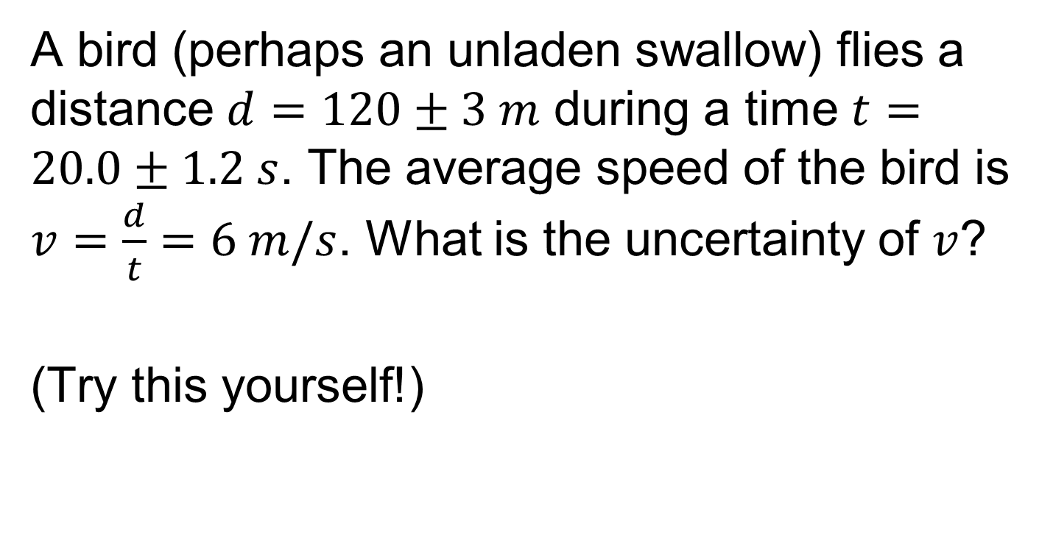
Example
A bird (perhaps an unladen swallow) flies a distance $d=120±3 m$ during a time $t=20.0±1.2 s$. The average speed of the bird is $v=\frac{d}{t}=6 m/s$. What is the uncertainty of $v$?
(Try this yourself!)

Slide 21

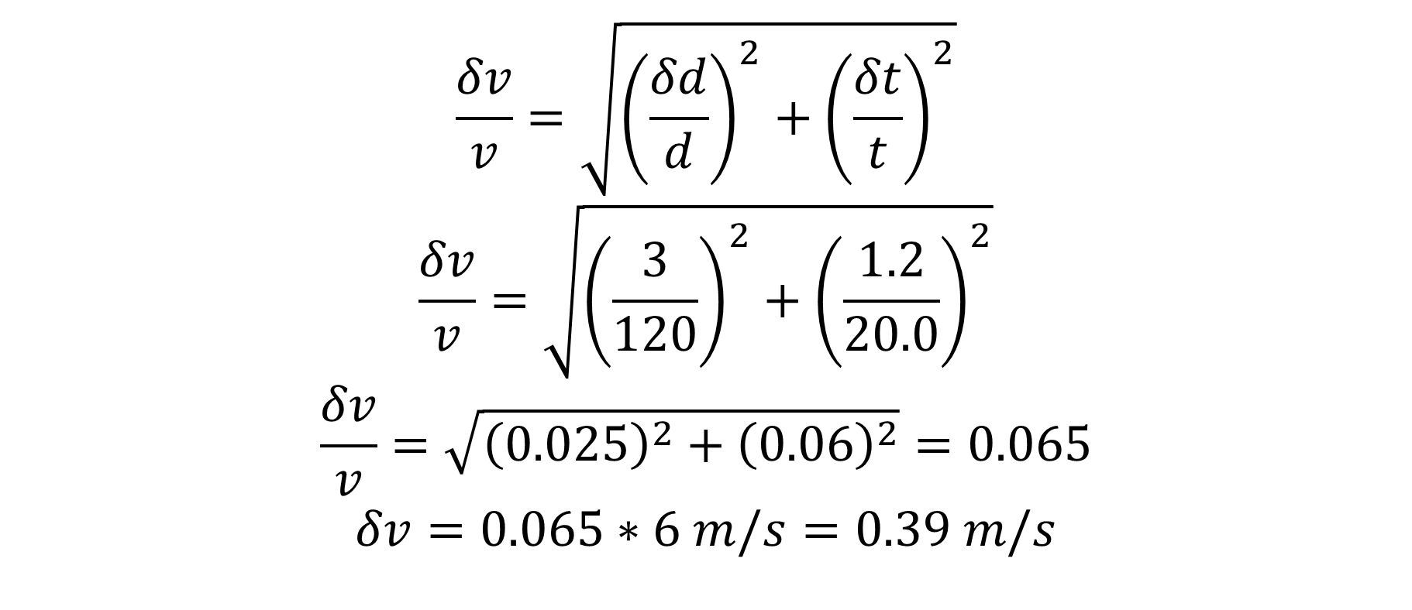
Example cont.
$$\frac{δv}{v}=\sqrt{{\left(\frac{δd}{d}\right)}^{2}+{\left(\frac{δt}{t}\right)}^{2}}$$
$$\frac{δv}{v}=\sqrt{{\left(\frac{3}{120}\right)}^{2}+{\left(\frac{1.2}{20.0}\right)}^{2}}$$
$$\frac{δv}{v}=\sqrt{{\left(0.025\right)}^{2}+{\left(0.06\right)}^{2}}=0.065$$
$$δv=0.065∗6 m/s=0.39 m/s$$
Given:
$$d=120±3 m$$
$$t=20.0±1.2 s$$
$$v=\frac{d}{t}=6 m/s$$

Slide 22
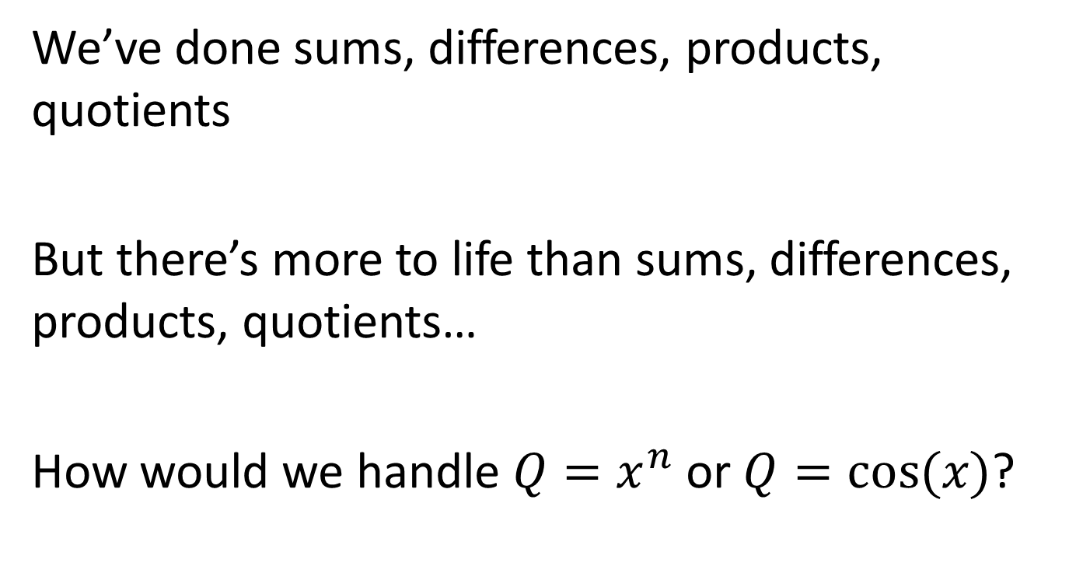
Arbitrary functions of one variable
We’ve done sums, differences, products, quotients
But there’s more to life than sums, differences, products, quotients…
How would we handle $Q=x^{n}$ or $Q=cos⁡(x)$?

Slide 23
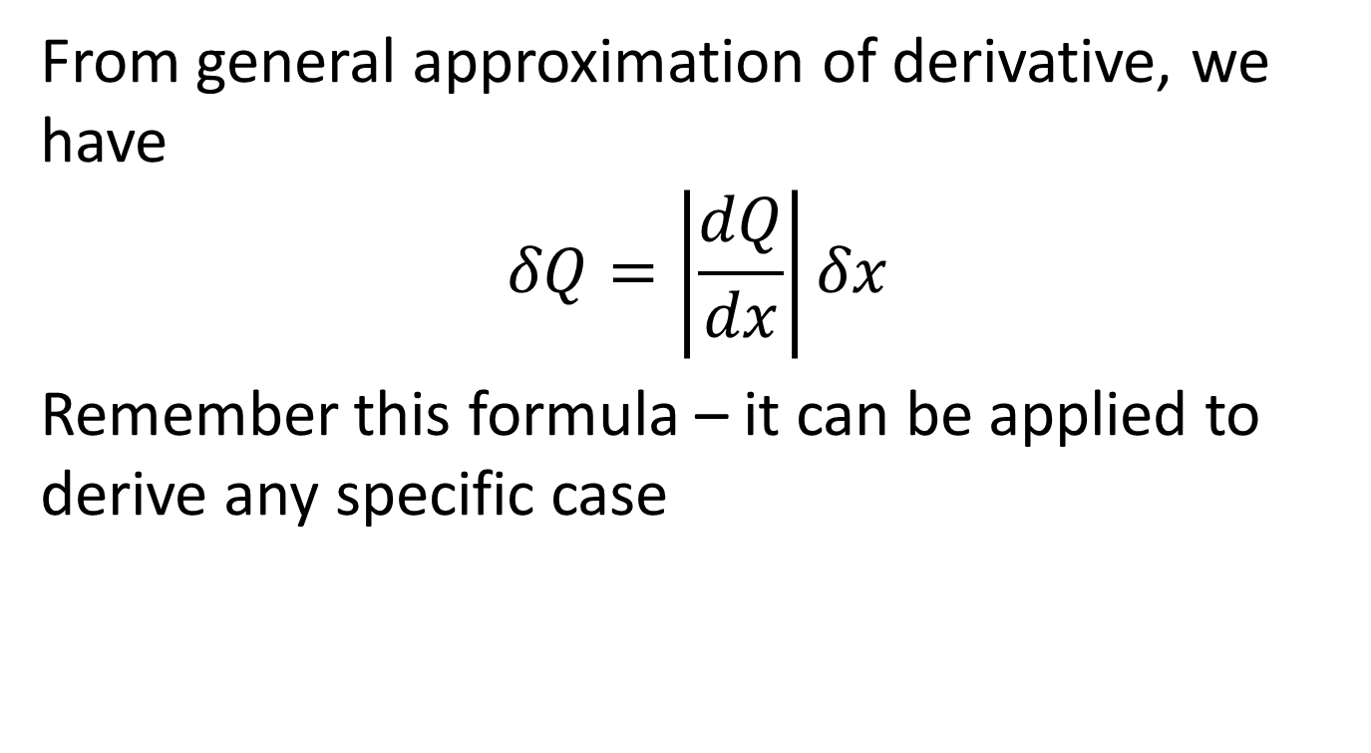
General formula
From general approximation of derivative, we have
$$δQ=\left|\frac{dQ}{dx}\right|δx$$
Remember this formula – it can be applied to derive any specific case

Slide 24
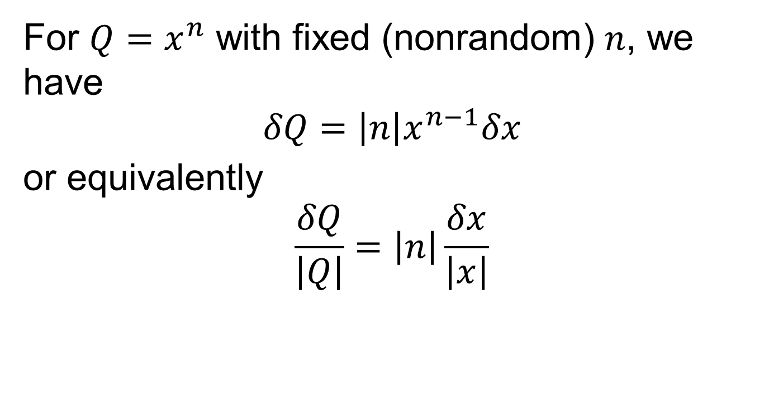
Raising to a power – important specific case
For $Q=x^{n}$ with fixed (nonrandom) $n$, we have
$$δQ=\left|n\right|x^{n−1}δx$$
or equivalently
$$\frac{δQ}{\left|Q\right|}=\left|n\right|\frac{δx}{\left|x\right|}$$

Slide 25
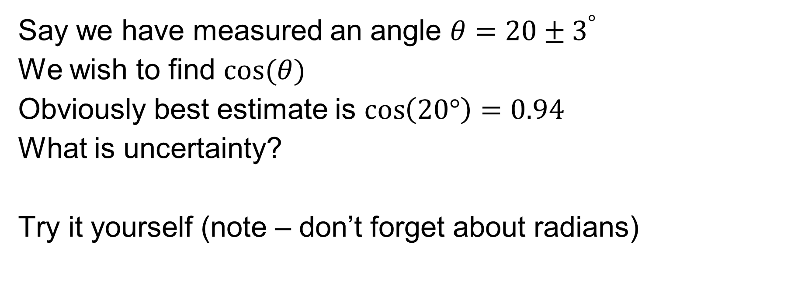
Example – uncertainty in a cosine
Say we have measured an angle $θ=20±3^{°}$
We wish to find $cos⁡(θ)$
Obviously best estimate is $\cos\left(20°\right)=0.94$
What is uncertainty?
Try it yourself (note – don’t forget about radians)

Slide 26
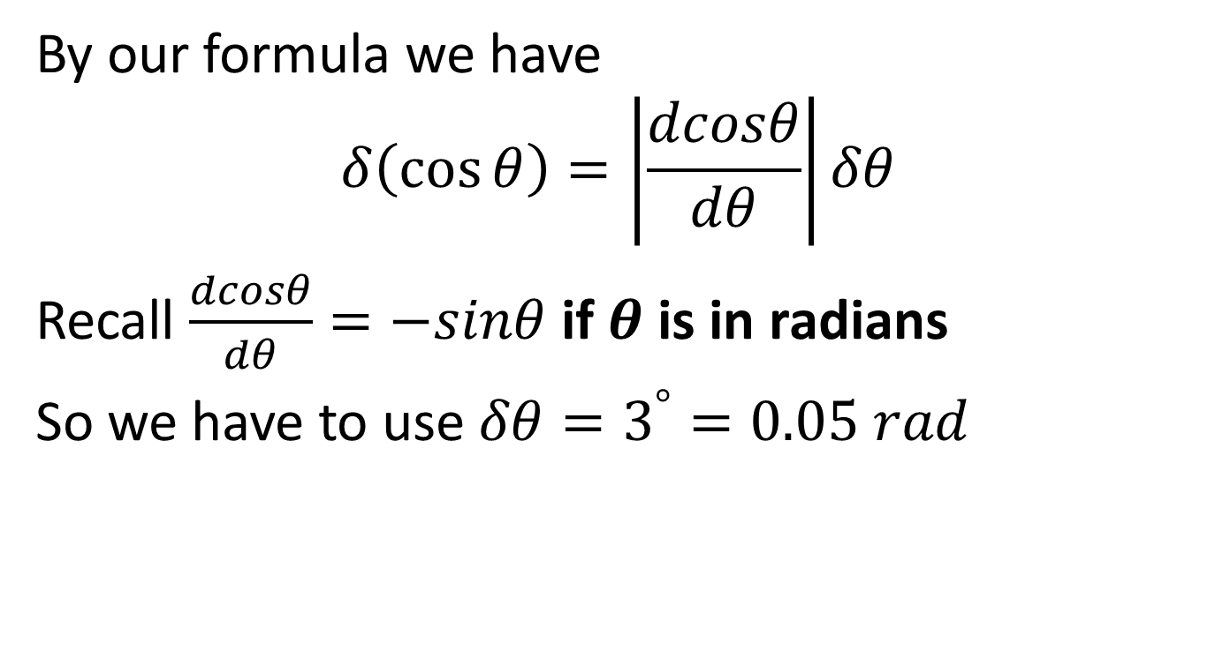
Example cont.
By our formula we have
$$δ\left(\cos{θ}\right)=\left|\frac{dcosθ}{dθ}\right|δθ$$
Recall $\frac{dcosθ}{dθ}=−sinθ$ if $θ$ is in radians
So we have to use $δθ=3^{°}=0.05 rad$

Slide 27
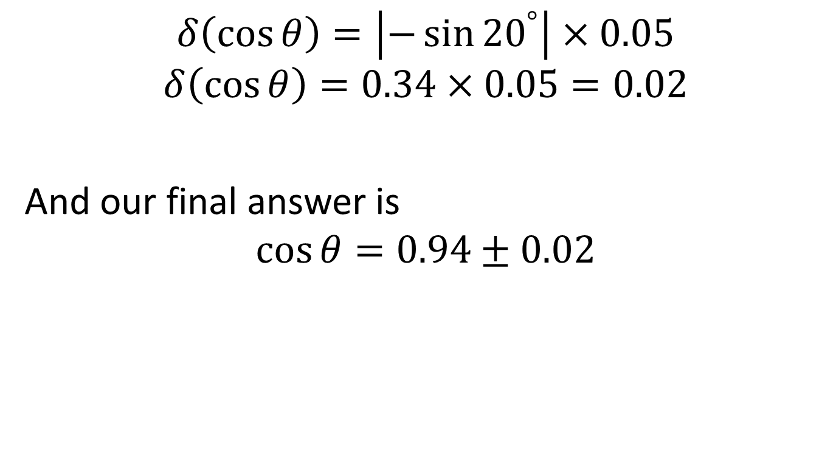
Example cont.
$$δ\left(\cos{θ}\right)=\left|−\sin{{20}^{°}}\right|×0.05$$
$$δ\left(\cos{θ}\right)=0.34×0.05=0.02$$
And our final answer is
$$\cos{θ=0.94±0.02}$$

Slide 28
Combinations
Many formulae are mixtures of different operations
You can use the rules presented in combination to derive the uncertain of the calculated value

Slide 29
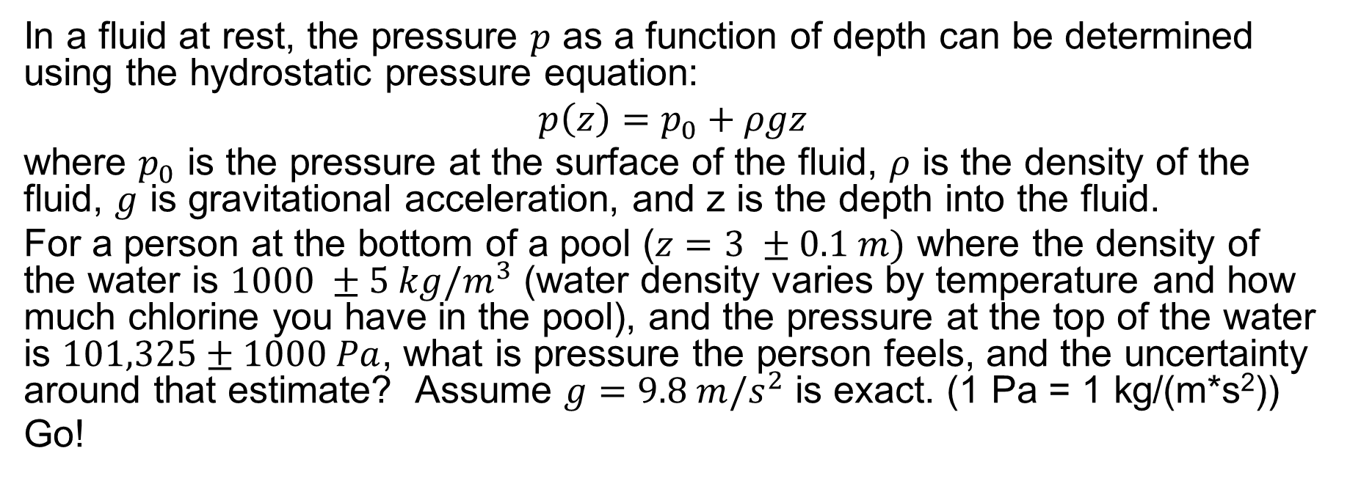
Example
In a fluid at rest, the pressure $p$ as a function of depth can be determined using the hydrostatic pressure equation:
$$p\left(z\right)=p_{0}+ρgz$$
where $p_{0}$ is the pressure at the surface of the fluid, $ρ$ is the density of the fluid, $g$ is gravitational acceleration, and z is the depth into the fluid.
For a person at the bottom of a pool ($z=3 ±0.1 m)$ where the density of the water is $1000 ±5 kg/m^{3}$ (water density varies by temperature and how much chlorine you have in the pool), and the pressure at the top of the water is $101,325±1000 Pa$, what is pressure the person feels, and the uncertainty around that estimate? Assume $g=9.8 m/s^{2}$ is exact. (1 Pa = 1 kg/(m*s²))
Go!

Slide 30
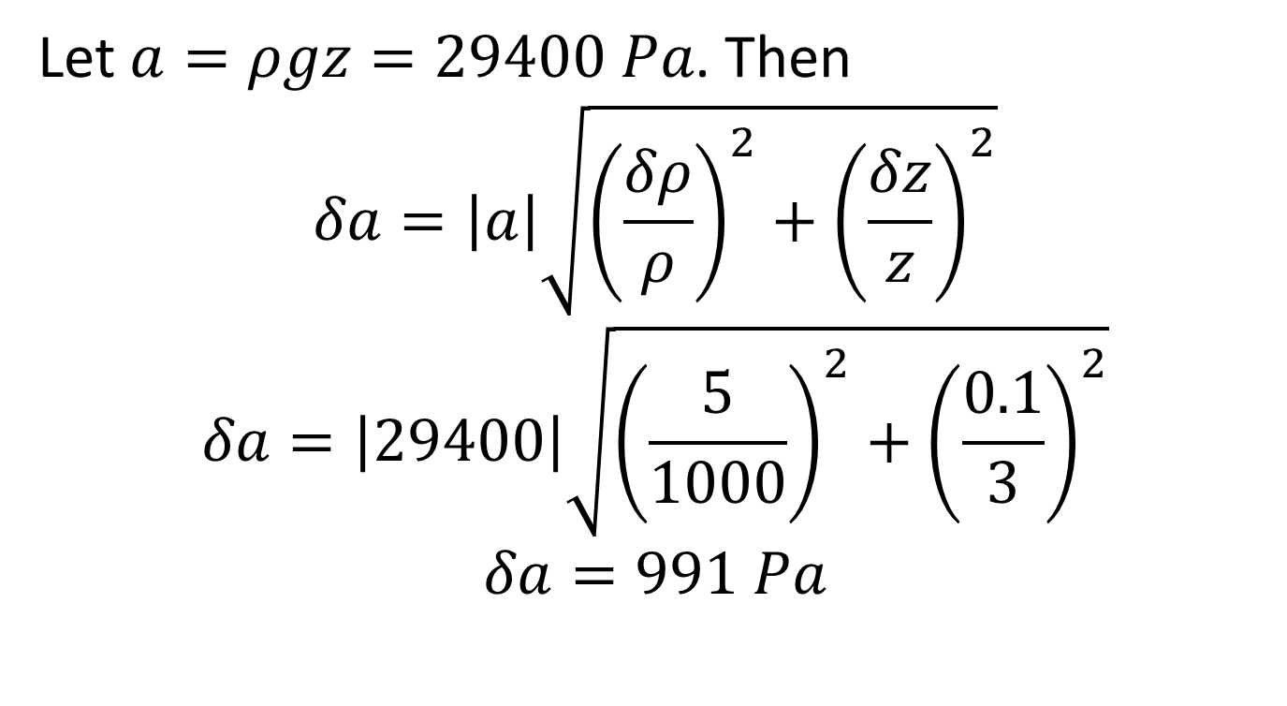
Answer
Let $a=ρgz=29400 Pa$. Then
$$δa=\left|a\right|\sqrt{{\left(\frac{δρ}{ρ}\right)}^{2}+{\left(\frac{δz}{z}\right)}^{2}}$$
$$δa=\left|29400\right|\sqrt{{\left(\frac{5}{1000}\right)}^{2}+{\left(\frac{0.1}{3}\right)}^{2}}$$
$$δa=991 Pa$$

Slide 31
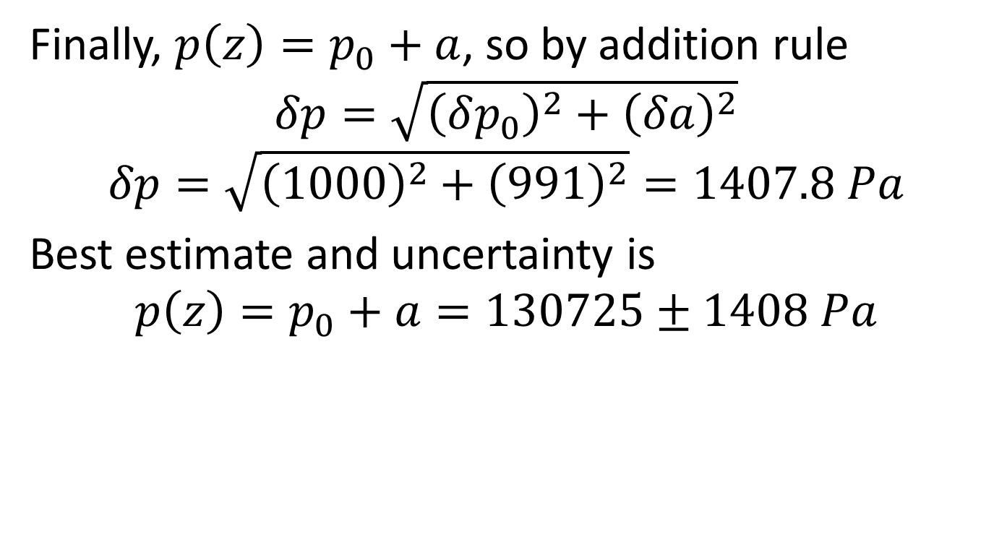
Finally, $p\left(z\right)=p_{0}+a$, so by addition rule
$$δp=\sqrt{{\left(δp_{0}\right)}^{2}+{\left(δa\right)}^{2}}$$
$$δp=\sqrt{{\left(1000\right)}^{2}+{\left(991\right)}^{2}}=1407.8 Pa$$
Best estimate and uncertainty is
$$p\left(z\right)=p_{0}+a=130725±1408 Pa$$

Slide 32
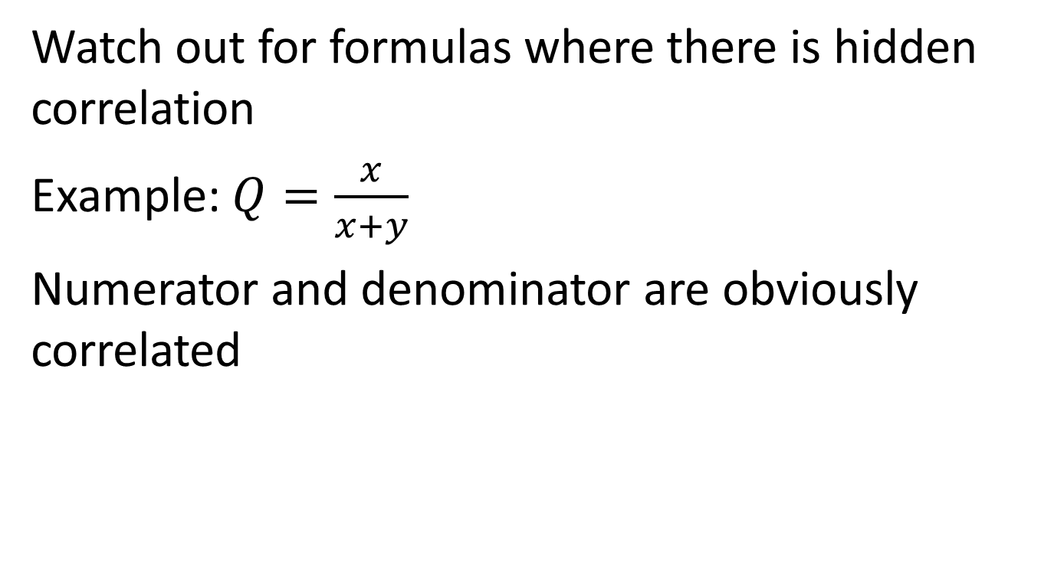
Uncorrelation is vital
Watch out for formulas where there is hidden correlation
Example: $Q=\frac{x}{x+y}$
Numerator and denominator are obviously correlated

Slide 33
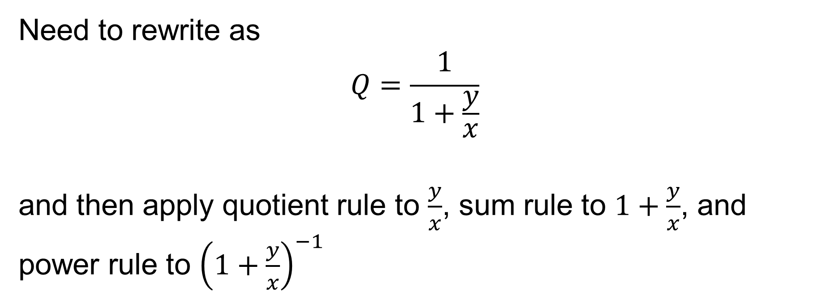
Need to rewrite as
$$Q=\frac{1}{1+\frac{y}{x}}$$
and then apply quotient rule to $\frac{y}{x}$, sum rule to $1+\frac{y}{x}$, and power rule to ${\left(1+\frac{y}{x}\right)}^{−1}$

Slide 34
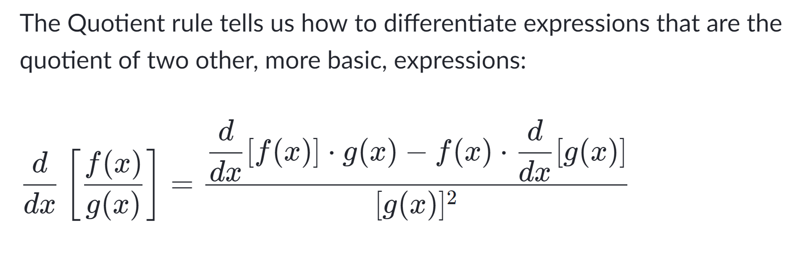
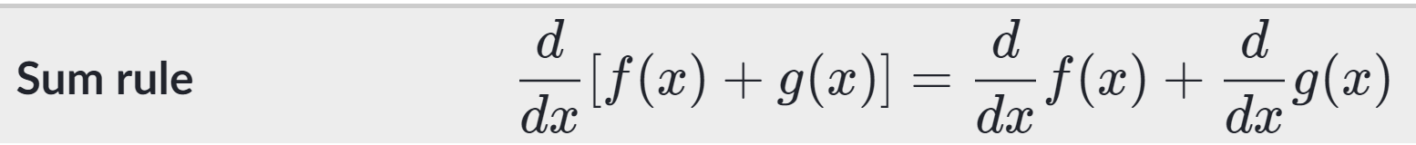
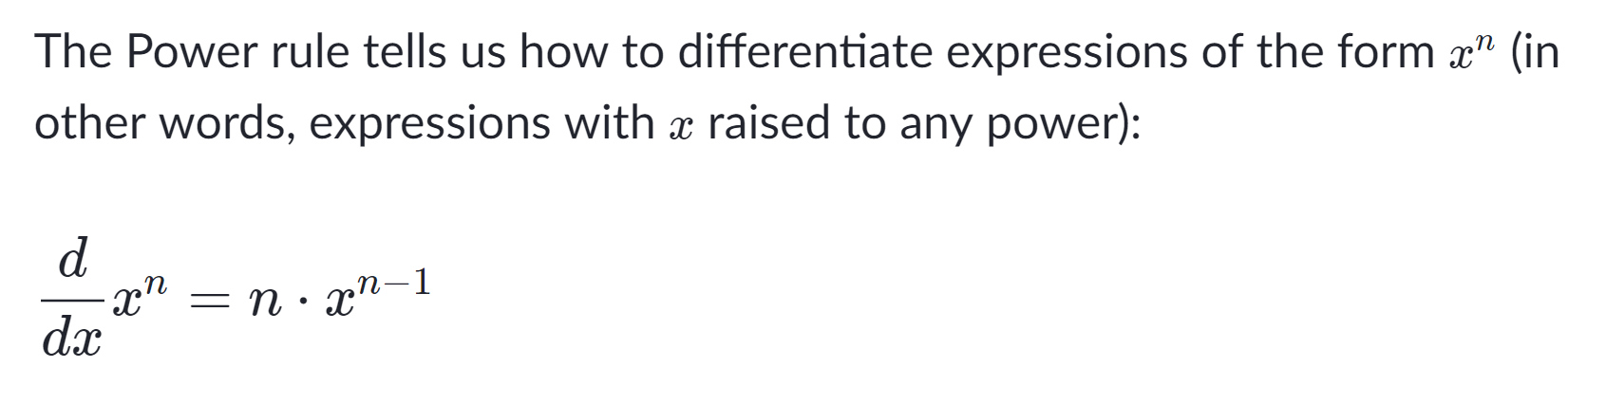
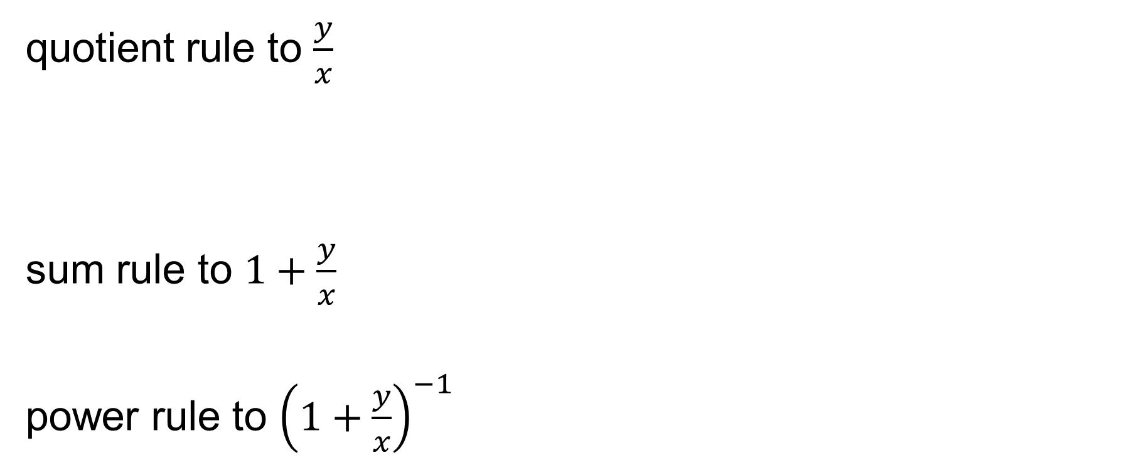
quotient rule to $\frac{y}{x}$
sum rule to $1+\frac{y}{x}$
power rule to ${\left(1+\frac{y}{x}\right)}^{−1}$
Source: Khan academy

Slide 35
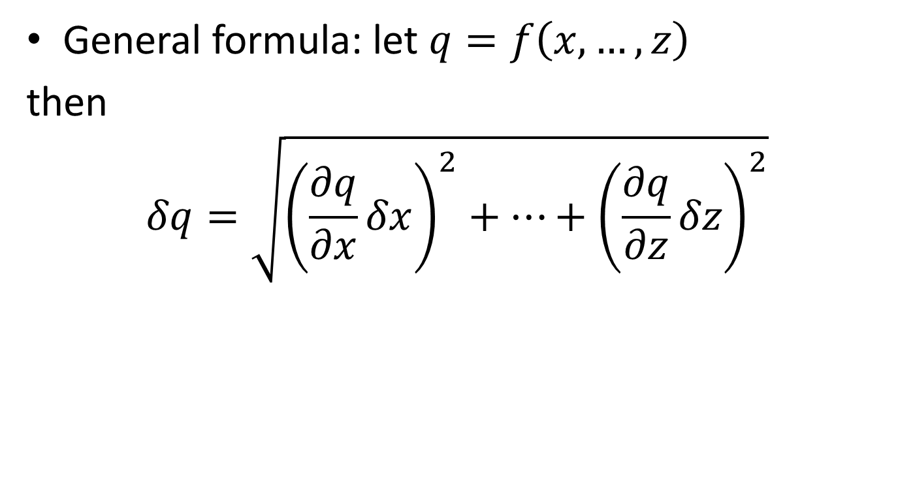
Uncertainty in a function of several variables
General formula: let $q=f\left(x,…,z\right)$
then
$$δq=\sqrt{{\left(\frac{∂q}{∂x}δx\right)}^{2}+…+{\left(\frac{∂q}{∂z}δz\right)}^{2}}$$

Slide 36
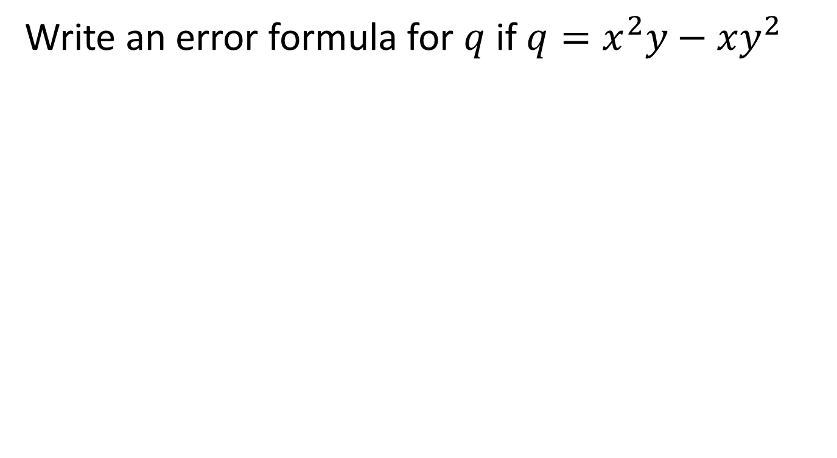
Example
Write an error formula for $q$ if $q=x^{2}y−xy^{2}$

Slide 37
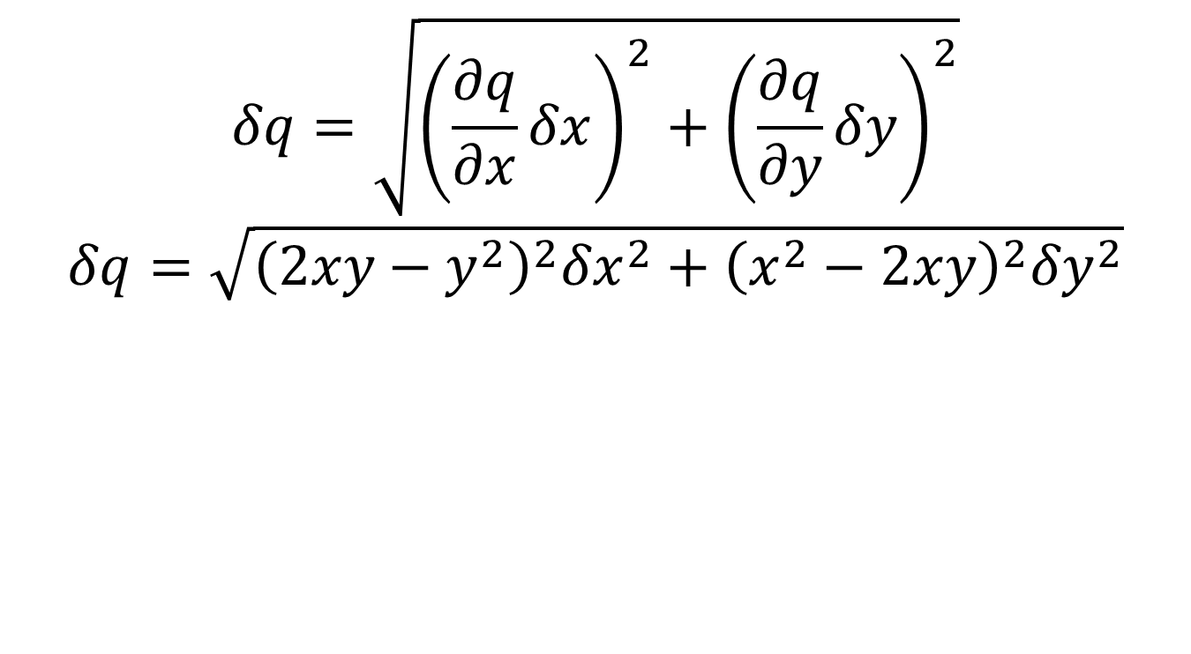
Answer
$$δq=\sqrt{{\left(\frac{∂q}{∂x}δx\right)}^{2}+{\left(\frac{∂q}{∂y}δy\right)}^{2}}$$
$$δq=\sqrt{{\left(2xy−y^{2}\right)}^{2}{δx}^{2}+{\left(x^{2}−2xy\right)}^{2}{δy}^{2}}$$

Slide 38
Questions?
HW 1 is posted.
Consult eCampus for due date. Use good time management skills!
Read lab write-up and all supplemental doc before lab (see Community page on eCampus)!

